Slide 1
Overview:
Software Modeling & UML Notation
COMP 3700: Software Modeling and Design
Tuesday, January 17, 2017
Gomaa, 2011; Pettit, 2014

Slide 2
Software Modeling and Design
Origins of Modeling
  Vitruvius, De Architectura, 1st century B.C.
  Architectural models
Modeling in science and engineering
  Build model of system at some level of precision and detail
  Analyze model to get better understanding of system
Software Modeling
  Modeling is designing of software applications before coding

Slide 3
The Need for Models
A model is…
  An abstraction that allows us to represent varying layers of complex information
Models help us…
  Organize
  Communicate
  Reason
  Analyze
Tradeoffs
  Larger effort
  Delayed return
  Additional skills requred

Slide 4
Why do we bother to model?
Programming in the small is no longer feasible for most applications
Software size is increasing exponentially
  Abstraction is essential to contain the complexity
Most problems with software system occur when different pieces have to interact
  Still a poorly understood problem
  Problems often discovered late and with a great cost
  Often leads to performance issues as well

Slide 5
Modeling and Analysis for Risk Mitigation
Early modeling and analysis can reduce incidental complexity
  Incidental complexity arises from choices we make during requirements, architecture, design, and coding
Model-based methods can
  Ensure consistency from requirements -> architecture ,> design -> code
  Detect deviations from development standards
  Assist trade studies in hardware/software architectures
  Point to problems with performance and reliability in the early stages
  Locate potential issues such as deadlocks and race conditions while they can still be repaired
Models have become the primary artifacts of software development
  May or may not include code generation
  Much more rigorous models than previously used in software design

Slide 6
Unified Modeling Language (UML)
UML is the standard modeling language for object-oriented software designs
  Version 1.4 – large legacy based supported by many tools
  Version 2.0** – update to prior version, most modern tool releases now support this
  Version 2.4.1 – absolute latest – limited too support
Types of Models include…
  Use Case Models
    Capture black-box functional requirements
  Activity Models
    Model detailed interactions within use case
  Static Models
    Capture structural elements
  Dynamic Models
    Capture behavioral elements

Slide 7
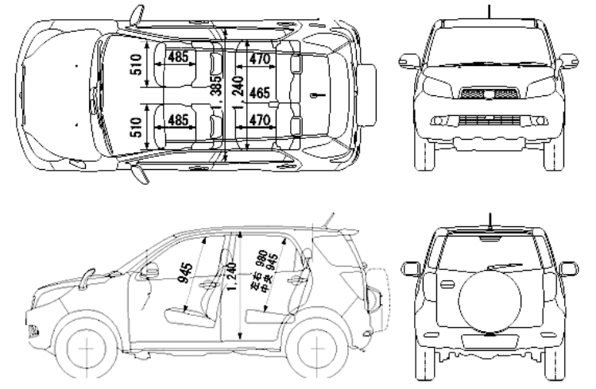
Different Modeling Views
…to help understand different aspects of the system AND allows us to use abstraction to focus on one piece of the puzzle at a time

Slide 8
Overview of Software Modeling and Design Method
Collaborative Object Modeling and architectural design mEThod (COMET)
  Object-oriented Analysis and Design Method
  Uses UML notation
    Standard approach for describing software design
  COMET = UML + Method

Slide 9
Overview of Software Modeling and Design Method
COMET:
  Provides steps and guidelines for
    Software Modeling and Design
    From Use Case Models to Software Architecture

Slide 10
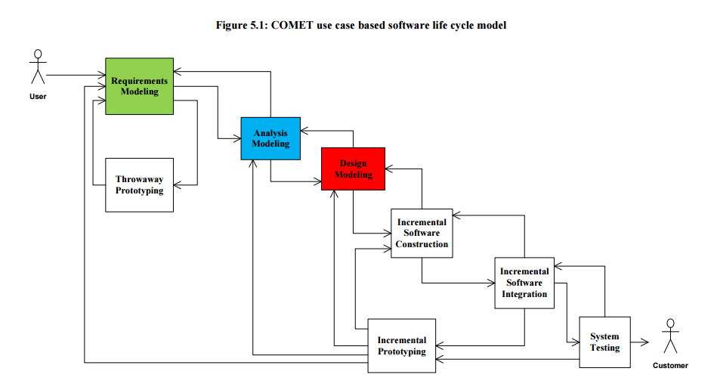
COMET Use Case Based Software Life Cycle Model

Slide 11
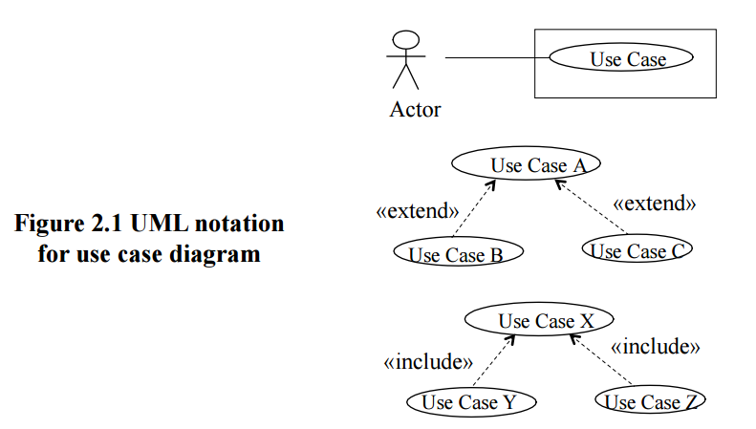
Requirements Modeling
Use Case Modeling
  Define software functional requirements in terms of use cases and actors

Slide 12
Analysis Modeling
Analysis Modeling consists of
  Static Modeling
    View of the system that does not change with time
  Dynamic Modeling
    View of system that does change with time

Slide 13
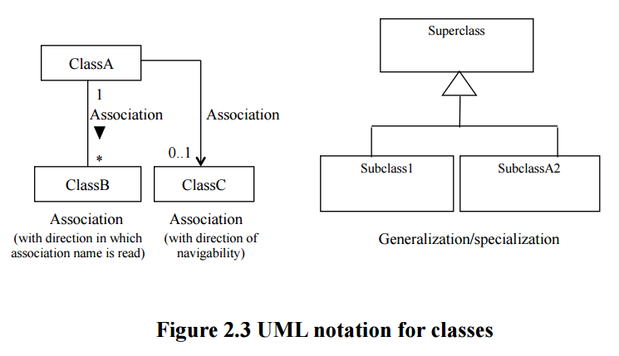
Analysis Modeling
Static Modeling
Defines structural relationships between classes
  Depicts classes and their relationships on class diagrams

Slide 14
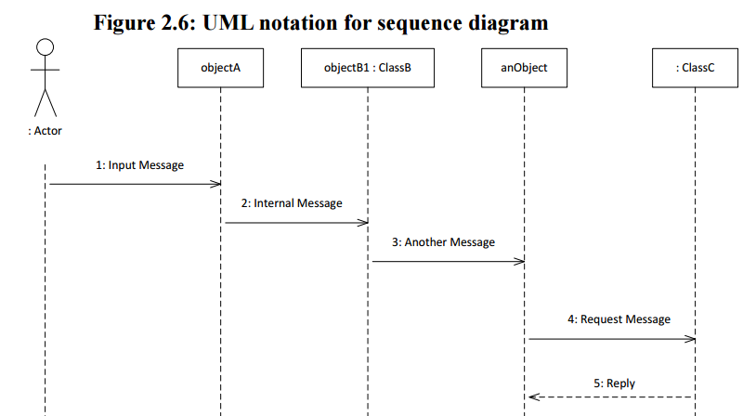
Analysis Modeling
Dynamic Modeling
  Defines sequence of objects communicating with each other using communication diagrams or sequence diagrams

Slide 15
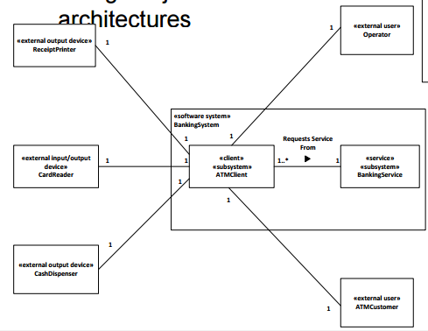
Design Modeling
Develop overall software architecture
  Structure system into subsystems
  Design object-oriented software architectures

Slide 16
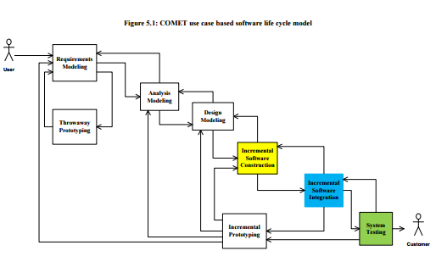
COMET Software Life Cycle
Incremental Software Construction
  Select subset of system based on use cases
  For each class in subset
    Detailed design in Pseudocode
      Structured English
    Coding
      E.g., Java
    Unit test
      Test individual objects
      (instantiated from classes)

Slide 17
COMET Software Life Cycle
Incremental Software Construction
Incremental Software Integration
  Integration testing of each system increment
  Integration test based on use cases

Slide 18
COMET Software Life Cycle
Incremental Software Construction
Incremental Software Integration
System Testing
  Testing of software functional requirements
  Based on use cases

Slide 19
Course Tools
Subversion (SVN) tools (free):
  Tortoise SVN – SVN client for Windows only
  SCPlugin – SVN client for Mac OSX (but NOT Snow Leopard)
  Svn – command line (Windows
UML Tools
  Violet UML (free) – open source UML tool
  ArgoUML (free) – open source UML tool
Project Scheduling Tools
  OpenProj (free) – open source version of MS Project
  Mirosoft Project – Industry standard project scheduling tool

